Slide 1
ARTview A Community Weather Radar Data GUI
Contributors
Anderson Gama
Nick Guy
Paul Hein
Jonathan Helmus
Timothy Lang

Slide 2

Outline
Introduction
Description
Show-and-tell

Slide 3
Open Source
There has been a concentrated move to open source tools in the Geosciences
This is especially true in Radar Meteorology
NCAR has led the way in the past with community tools (e.g. Solo editor, CEDRIC, TITAN, …)
Argonne National Laboratory recently picked up the baton by developing Py-ART
Right time, right people

Slide 4
ARM DoE Py-ART
Python Atmospheric Radiation Measurement Climate Research (ARM) Facility Radar Toolkit
Py-ART is a package for working with weather radar data in Python.
Allows one to read, visualize, an manipulate data
Available on Github/conda channel
http://arm-doe.github.io/pyart/
Serves as the basis for many other projects

Slide 5
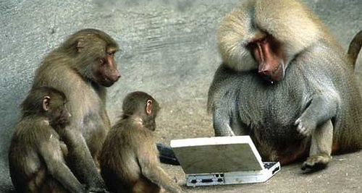
Work closely with Py-ART developers
Py-ART
Fan Club
ARTview
SingleDop
DualPol
PyBlock
AWOT
Brawl4d

Slide 6

Origins of ARTview
Postdoc life
Why bother?
Humble beginnings
Unexpected and exciting collaborations

Slide 7
Mission
View (browse), query, and edit radar data
Make it easy for novice weather radar data users, while providing advanced tools for experienced users
Provide alternative to Solo editing software with modernized interface (and other software in the future?)
Notes:
Different than other talks in that we are working on individual data files

Slide 8
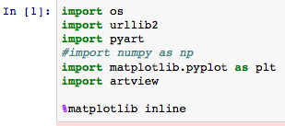

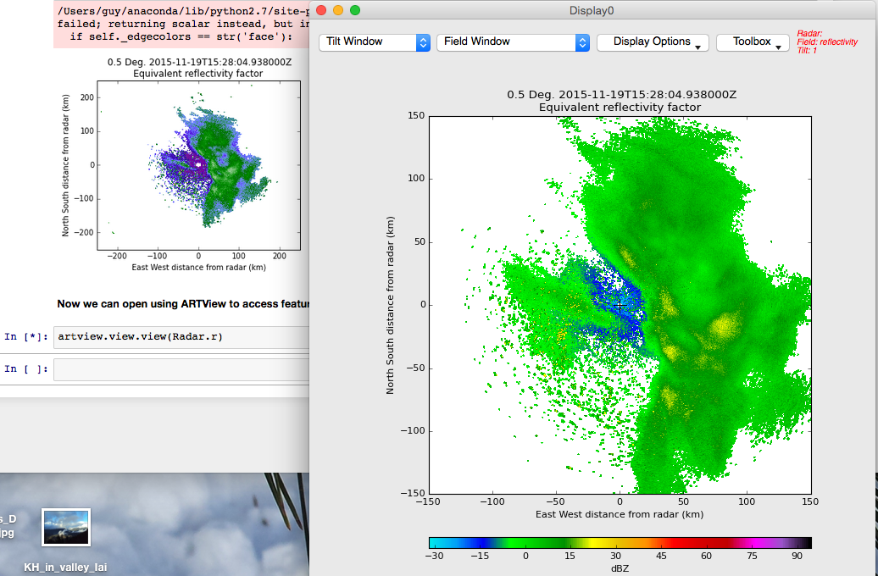
Launch from Jupyter Notebook.

Slide 9
Tools
Leverage Py-ART code base and provide internal functions to extend radar analysis
Leverage modern Qt GUI – PyQt/PySide
Add value to analyses
Save publication quality graphics
Notes:
Add value to analyses = combine the computational and graphical side, quickly perform complex analysis on single file before automation
Next see an example of querying data

Slide 10
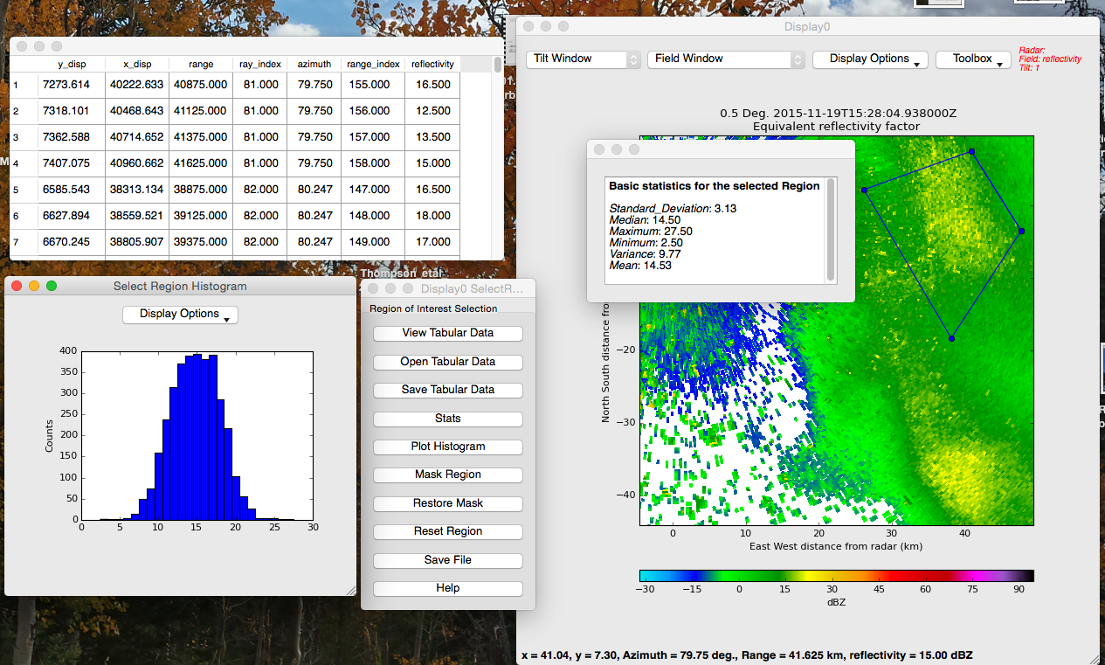
Query data by point or region. Get basic statistics.

Slide 11

Structure
Core
Shared variables
Points
Components
Link to Py-ART IO/Display
Hooks to Matplotlib
PyQt functionality
Plugins
Scripts for various modes of operation
Notes:
Py-ART standard data model
Shared variable was a game changer

Slide 12
Plugins
Allow data exploration and modification
Interact and change Py-ART radar objects
Connect existing Py-ART functions
Doppler velocity dealiasing, attenuation calculations, map-to-grid, etc.
Create native ARTview functions
Manual unfold, filter the data by region or values, open console to interact via command line, etc.
Users can contribute functions
Examples provided, once saved locally they are loaded automatically
Hopefully share with the community
Simplify access through Modes selection

Slide 13
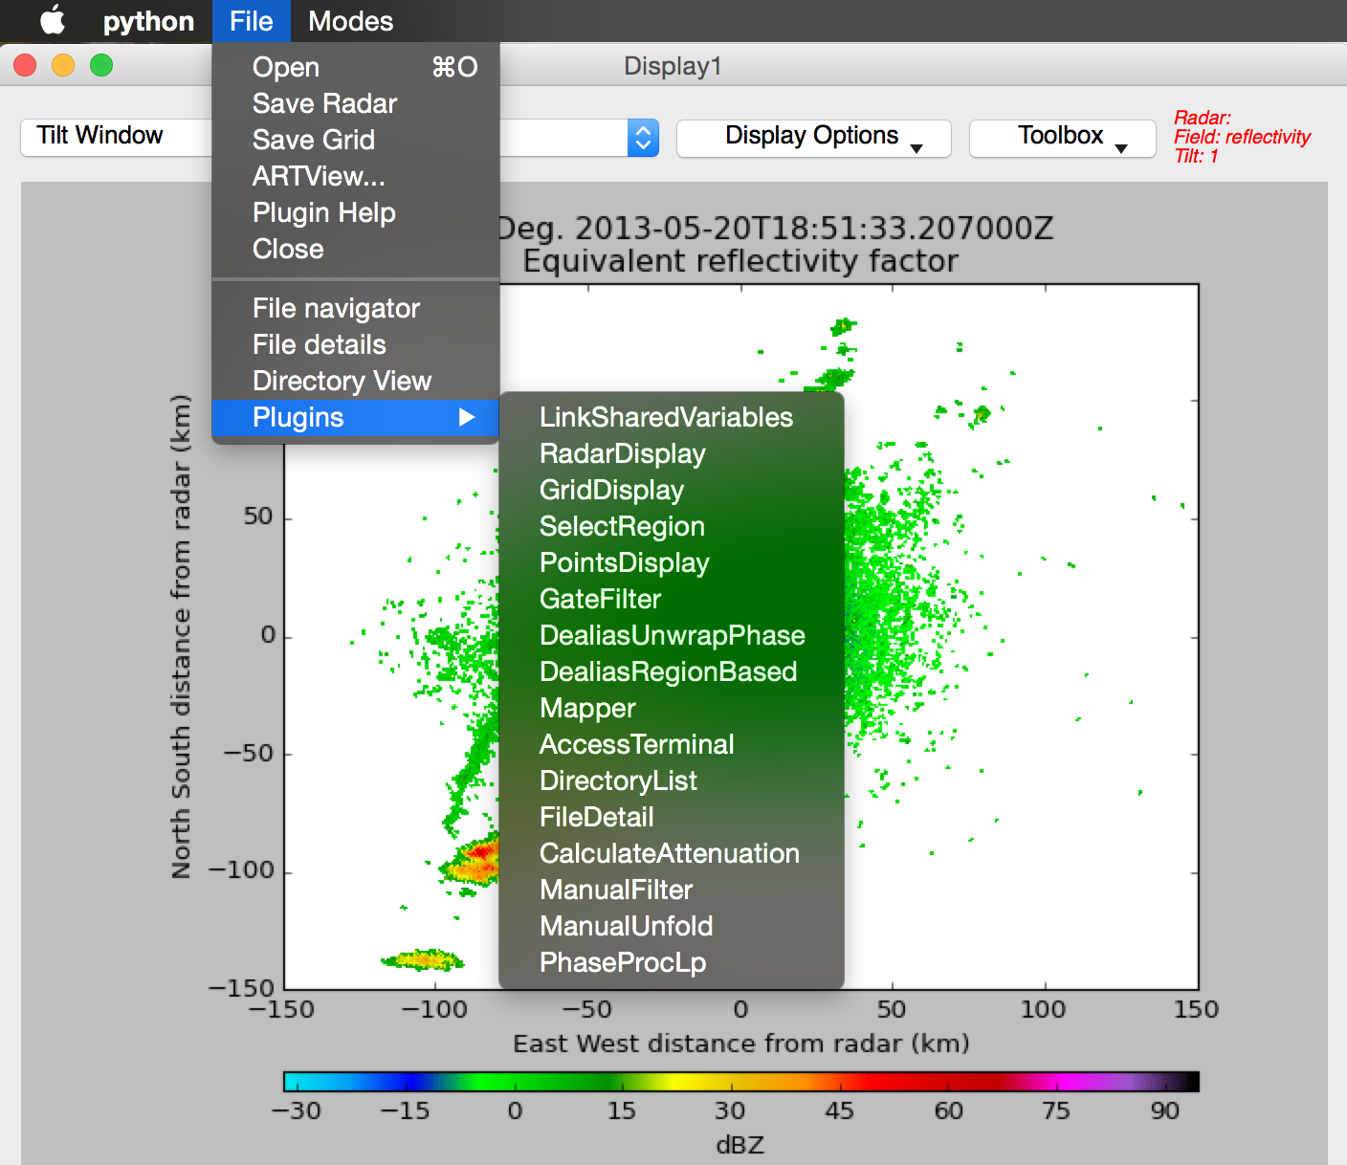
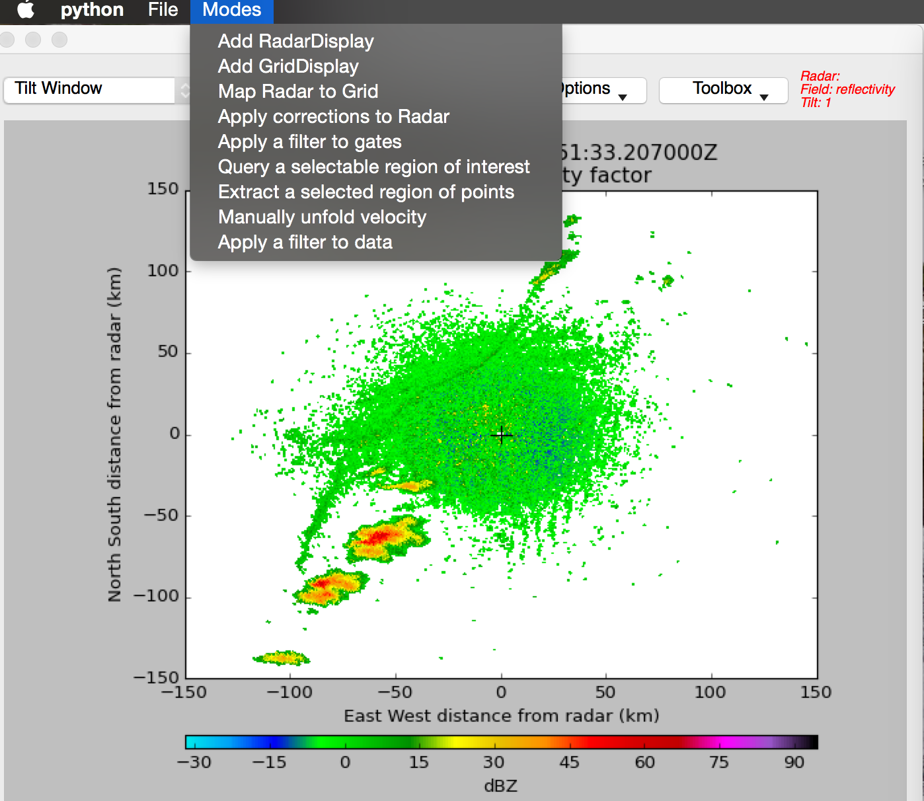
Plugin List.
Predefined Modes.

Slide 14
Highlights
January 2015
Reformatted from single script to installable package
Modified core architecture
Rapid plugin development
August 2015
First official release (v1.0) just before the AMS Radar Meteorology Conference
Extending rapidly thereafter
March 2016
Release v1.2
Extensive aesthetic and user redesign
Conda package
Video tutorials
Notes:
The first points were started around Jan 2015

Slide 15

Current Projects
Working on v1.3
Continue to simplify use
Implement more data editing
Squish some bugs
Improved Documentation

Slide 16
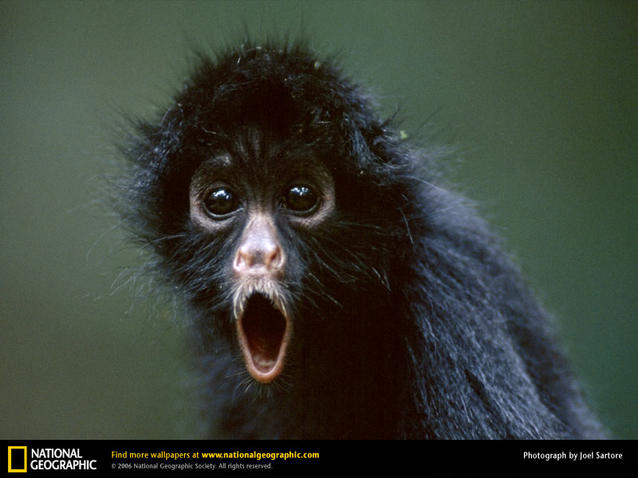
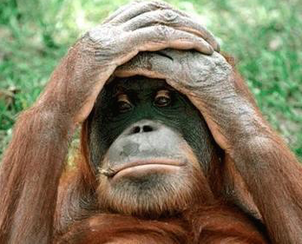
Challenges
We have users
And they have suggestions and problems
Follow best practices
Keeping the momentum

Slide 17
Going Forward
Continue v1.3 development – laundry wish list
Link from NCAR server as Solo alternative
Working on Py-ART 1.7 integration
Discrete colorbar values, locking colorbar, add text to images, develop a RadarCollection object to handle multiple instances (speed things up?)
Of course fixing bugs and improving documentation
Code base available at:
https://github.com/nguy/artview

Slide 18

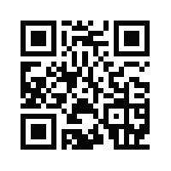

Questions/Comments?
Thanks for listening
Please visit us! http://nguy.github.io/artview

